Slide 1
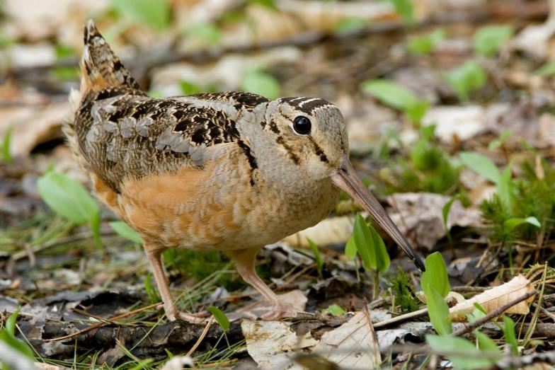
American Woodcock Singing-ground Survey Observer Training Tool

Slide 2
Singing-ground Survey (SGS) Participants
This is a cooperative survey between
U.S. Fish and Wildlife Service (USFWS)
Canadian Wildlife Service (CWS)
State Conservation Agencies
other federal government organizations
Birds Canada
and volunteers
The Migratory Bird Program within the USFWS is responsible for overall coordination and compiling, managing, and reporting the data. Birds Canada is responsible for maintaining the NatureCounts data entry platform. The United States Geological Survey (USGS) is responsible for data analysis. All other mentioned participants are state, provincial, or regional coordinators and survey observers.

Slide 3
Singing-ground Survey Background
The Singing-ground survey, in its present form, began in 1968.
There are approximately 1,500 Singing-ground Survey routes randomly placed throughout the heart of the woodcock breeding range in Canada and the United States. These routes were placed across the landscape, covering all habitat types.
It is one of three surveys used to monitor woodcock population status in North America and it provides managers with an index to the relative woodcock population size.
The survey takes advantage of the conspicuous breeding call of male American woodcock that can best be described as a “peent.”

Slide 4
Importance of the Singing-ground Survey
The survey provides a long-term data set to guide the management of woodcock in North America. The survey detected long-term population declines throughout the species’ range.
Biologists used data from the survey to develop explicit population and habitat goals for the American Woodcock Conservation Plan that was completed in 2008.
The population index derived from the survey is the primary metric used for the U.S. harvest strategy developed cooperatively by the USFWS and Flyways in 2010.
Researchers have used data from the survey to build spatially explicit models showing the relationship between woodcock abundance and landscape-level habitat variables.

Slide 5
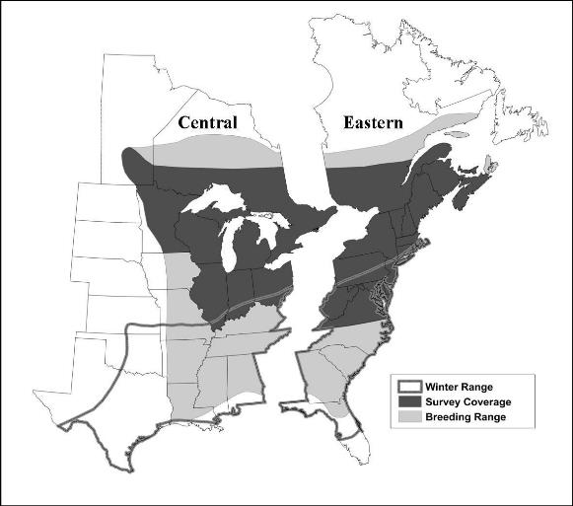
American Woodcock Range and Survey Coverage
Two management Units: Eastern and Central Management Units
Management units follow the Atlantic and Mississippi Flyway boundaries
Management unit boundaries are based on historical band return data
The Singing-ground Survey only covers the core part of the woodcock breeding range in North America

Slide 6
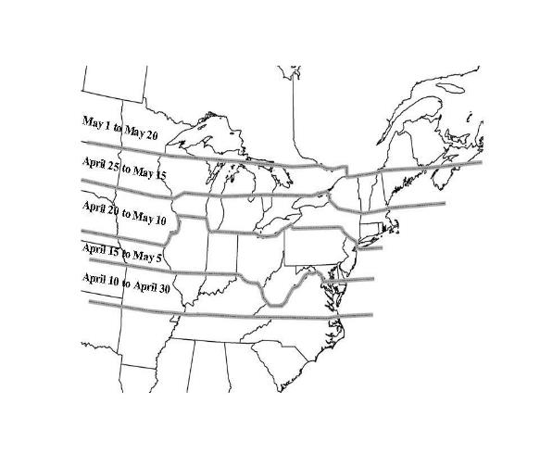
Timing of Singing-Ground Survey Routes
There are 5 survey windows based on latitude and spring phenology within the northern portion of the woodcock breeding range
Survey dates range from April 10th to May 20th depending on latitude of route
If your route is near the edge of a window use this website to figure out which one it falls into.
https://databasin.org/maps/new#datasets=49f3cb92334b4f359fb01eb39e9920ec

Slide 7
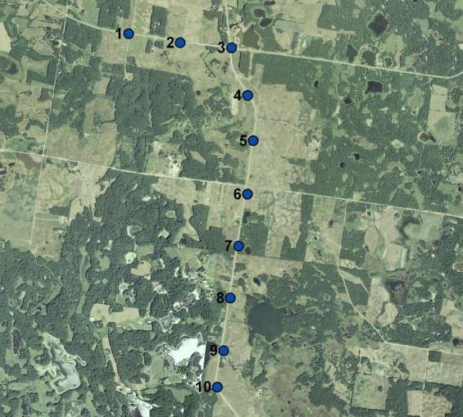
Specific Singing-ground Survey Protocols
There are 10 stops per Singing-ground Survey route
Stops are spaced 0.4 mi (0.6 km) apart for a total of 3.6 mi (5.4 km)
Route should start 22 minutes after sunset if the sky is ≤ ¾ overcast or 15 minutes after sunset if the sky is >¾ overcast
Each stop is surveyed for a period of 2 minutes
Route must be completed within 38 minutes of start time
Start Point
0.0 mi/km
Finish Point
3.6 mi/5.4 km
Sample Singing-ground Survey route from Minnesota showing stop locations

Slide 8
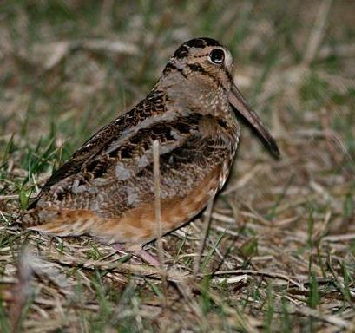
Behavior of Breeding American Woodcock
Male makes a “peenting” call on the ground during courtship
Courtship also includes an aerial display where a whistling sound is made by the outer wing feathers
Displays are typically conducted in an opening such as a clear-cut or field
Observers only record the number of males heard “peenting” at each stop

Slide 9
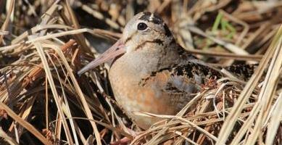
Listen to hear the peent & aerial display of the American Woodcock
The recording starts out with a series of peents and then the woodcock starts to perform the aerial display or what some people call the flight song. Further along you again hear a series of peents and another aerial display.
When in the field, it is important that you can distinguish the peenting sound from other birds, insects, or frogs/toads that might sound similar.
If you are a new observer, it might be helpful to go out with someone who has already conducted a woodcock route and head to a spot where you know woodcock will be peenting.
If interested, You Tube also has videos showing woodcock peenting.
© Brett Pikula

Slide 10
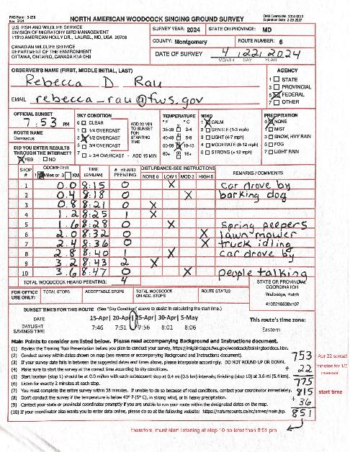
Parts of a Singing-ground Survey Data Sheet
Route location information and the date the route was completed are recorded in this section.
Observer data including name, affiliation, and the observer’s email address are recorded in this section.
Sunset time, route name, weather related data, and Internet data entry are recorded in this section.
Data for each stop are recorded in this section including: 1) odometer reading, 2) listening start time at each stop, 2) number of individual males heard peenting, 3) disturbance levels, and 4) any additional remarks.
State/provincial coordinator contact information is also listed in this section.
The National SGS Coordinator completes the “Office Use Only” section within the database after validating that the data has followed proper protocols.
Sunset times for the route are listed in this section.
Main protocols to follow while conducting the survey are listed here. Detailed survey instructions can be found on the back of the survey form or with accompanying documents.
Manual calculation to obtain start and end times.
Notes:
make animated to highlight each section as you move through the form

Slide 11
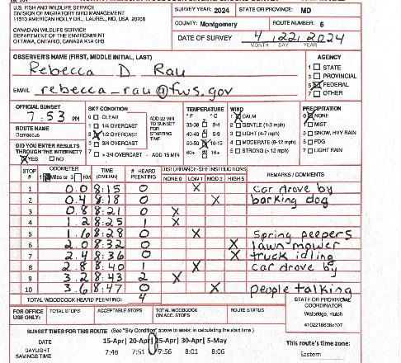
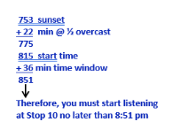
Calculating sunset & survey window (start to finish times)
Determine the date you will run the survey.
Locate the dates and corresponding suggested sunset times for your route located near the bottom of your survey form. These are unique to the route number printed on your form.
Interpolate the sunset time based on the date you want to run your route. For example, if you run your route on the 22-Apr, then locate the dates 20-Apr & 25-Apr on the form. Based on the suggested sunset times of 7:51 & 7:56, your sunset time should be 7:53 for the 22-Apr.
Write 7:53 underneath the Official Sunset field.
If the sky is clear or up to and including ¾ overcast, add 22 minutes to the sunset time to determine the start time at stop 1. Or, add 15 minutes if the sky is more than ¾ overcast. In this example, the sky is ½ overcast, so add 22 minutes to 7:53.
Your start time at stop 1 should be 8:15.
7:53

Slide 12
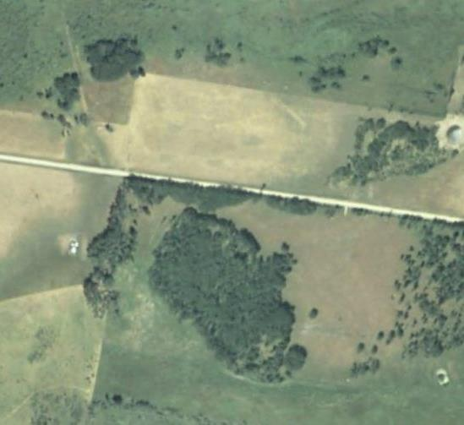
An Example Stop on a Singing-ground Survey Route
Three birds heard “peenting” at this stop and one heard doing its aerial display. Each bird’s location is indicated by a star
Each “peenting” bird was heard a different number of times during the 2-minute survey period as indicated
The observer only records the number of birds heard “peenting” (3), not the total number of “peents” heard (18) or the bird only heard doing the aerial display
In this example, the observer would record a total of 3 birds on the data sheet for stop #2
Bird #1 heard
peenting 5 times
Stop Location #2
Bird #3 heard
peenting 1 time
Bird #2 heard
peenting 12 times
Bird #4 heard flying but no peents heard

Slide 13
What is a C-Z Route?
In order to avoid expending unnecessary resources and funds, approximately two-thirds of the 1,500 routes are selected for survey each year. The remaining routes are designated as constant zero (C-Z) routes.
Routes for which no woodcock are heard for 2 consecutive years enter this constant zero status and are not run for the next 5 years. If woodcock are heard on a constant zero route when it is next run (reactivated), the route reverts to a normal status and is run again the next year. If woodcock are not heard, it reverts back to a constant zero status.
Data from constant zero routes are included in the analysis only for the years they were actually surveyed.
It is preferable to have the same observer who ran the route last, run the route again when it is to be reactivated.

Slide 14
Why continue to revisit C-Z Routes?
Some observers question why we continue to revisit these routes when no woodcock are heard or it runs through bad habitat.
We want to sample the entire population. If habitats were constant, and we could stratify the world into good and bad habitat, then we could put most of our effort into sampling good habitats. Unfortunately, the landscape is a mosaic of good and bad habitat, and that mosaic is shifting over time. So, a good spot for woodcock one year may not be good for them in the future, and good habitat appears in new places. We can't predict these changes, and don't want to be constantly restratifying and reallocating samples, so in order to ensure that we sample the entire population we have to sample the entire landscape.
If it seems as if your route is always “bad,” think of it this way….unless you have some data (0 woodcock = data) from those places you cannot ensure that you are sampling the entire population. For example, if we want an estimate for a particular area, like the state of MN, and we only survey positive routes and then project those numbers over the whole state, we would overestimate the population. There are only two ways around this: (i) project only to woodcock positive habitat (but then we have to determine what that is, which is not an easy task or (ii) sample all areas and thus account for the woodcock negative areas (this is really the best way to determine non-woodcock habitat, i.e., by actually recording where we don't find them!).
The fact is, to address these concerns we compromise the survey somewhat with the ad-hoc approach to constant zero routes. It is important to note that historically, woodcock surveys only did survey good spots. During the 1960's there were reviews of design that established the "better" statistical basis of the current survey.

Slide 15
Common Errors Seen During Data Validation Checks
Unfortunately, if an observer’s data sheet includes one of the errors below, it has a higher chance of not being included in the analyses. Please make sure you are aware of all instances below and try not to fall victim to any of them. Read over all instructions given to you prior to running your survey route. This will help prevent accidental errors.
Leaving fields blank on the data sheet – All fields are important and help aid USFWS personnel during the data validation checks. If we are missing data, we can’t properly edit the form in its entirety. Those entering data online for observers can’t do so if fields are left blank.
Surveying the route outside the date window without prior permission from USFWS personnel – In certain circumstances (other than related to spring phenology or weather conditions) an observer is not able to conduct their survey within the route’s date window. If this is the case, please contact USFWS personnel ahead of time to discuss the possibility of getting an extension. It is recommended that an observer aim to conduct the survey at the beginning of the survey window to allow for unpredictable circumstances such as weather, sickness, family emergencies, etc.
Listing two observers on one form – Proper protocol says that if 2 observers (old & new) are running a route at the same time, to record their results independently on separate forms. Date of survey, route name, official sunset, sky condition, temperature, wind, precipitation, odometer readings and times at each stop should match between observers’ survey forms.
Calculating the sunset or start time incorrectly – See slide 10 for correct protocol and explanation.
Starting before or extending beyond the time survey window – Peak times of singing activity occur between 22 and 58 minutes after sunset or, between 15 and 51 minutes after sunset on overcast evenings. Stops that fall within that time window are coded as acceptable. Any stop data that fall outside that time window does not get included in the data analysis and is coded as unacceptable. Furthermore, an earlier analysis revealed that routes with 8 or fewer acceptable stops tended to be biased low, therefore, only route observations with at least 9 acceptable stops are included in the analysis.
Counting the # of peents rather than individual woodcock heard at a stop – See Slide 11 for the correct protocol and explanation.
Incorrectly identifying first listening point – In this instance, the observer thinks that the starting point is not the first listening point, but rather he/she drives 0.4 miles from the start and then begins listening for woodcock, recording their results in the stop 1 line. This is incorrect. Start (0.0 mi/km) = Stop 1. Finish (3.6 mi/5.4 km) = Stop 10. You should start to listen for woodcock at the start (stop 1).
Using two different time sources – The observer should only use one source to pull times from at the start and each subsequent stop. For example, a car clock, cell phone or stopwatch. Doing otherwise they run the risk of each varying by a minute or two and those few minutes might confuse the person edit checking the survey form and cause unnecessary follow up.

Slide 16
Other Guidelines for Observers
The USFWS, Division of Migratory Bird Management (DMBM), is requesting assistance from state and province SGS observers to obtain GPS coordinates for routes that have not been previously collected or were incorrect. We are trying to finalize a spatial GIS database for the survey. This data will be uploaded into the NatureCounts website and allow for mobile data entry in the field. It will also be used to develop static route maps for coordinator distribution and stop location verification. In addition, the coordinates are necessary in any evaluations or studies that require the use of SGS spatial data. Your state or provincial coordinator will let you know the status of your route(s).
It is preferable that the same observer run the same route each year. If you are no longer able to run a route, please contact your state or provincial coordinator. If possible, please survey the route with your replacement during the transition year. This suggestion also applies to reactivated C-Z routes.
Please drive the route prior to running it in order to become familiar with the stops and any hazards (i.e. flooded or closed road) that may exist along the route.
If a route becomes unsafe through time, please contact your state or provincial coordinator to discuss relocating the route using the standard criteria developed for relocating unsafe routes. Please do not alter routes on your own!

Slide 17
Steps after Completing Singing-ground Survey
Enter your survey results on-line at https://naturecounts.ca/nc/amwo/main.jsp (NEW WEBSITE) unless your state or provincial coordinator has instructed you to do otherwise.
Make a copy of the original survey form for your files and send a copy to your state/provincial coordinator.
Why is it still required to send a copy to your state or province coordinator if the results are entered online?
In almost all cases observers write more on the survey form than they do within the remarks/comments section in the data entry website. This can help them catch hazardous conditions or explain why an observer took too long driving between stops. Having the hard form in hand also helps personnel identify possible data entry errors, typos, and helps answer questions about missing data. Many times, if there is a problem with the data in the database, they can find the answer on the form rather than having to contact the observer directly.
You no longer have to submit a copy to the USFWS in Laurel, Maryland, USA.
If, after conducting the survey, you feel as if a section or the entire route needs to be relocated, this is the time to contact the state or provincial coordinator and USFWS personnel.

Slide 18
Other Information for Observers
For 2024 only, all current documents pertaining to the Singing-ground Survey (normally included in your observer survey packet) can be found at the old data entry website: https://migbirdapps.fws.gov/woodcock/trainingtooldocs.htm. Once there you can download them to your computer in PDF form. In future years, all survey materials will be transferred to the Resources page on the NatureCounts website. https://naturecounts.ca/nc/amwo/resources.jsp.
If sunset times are not listed on your form, consult https://www.esrl.noaa.gov/gmd/grad/solcalc/
Annual American Woodcock Status Reports can be downloaded at https://www.fws.gov/library/collections/american-woodcock-population-status-reports
You can query and download Singing-ground Survey data (up through 2015) on-line at the USFWS’ Migratory Bird Data Center https://migbirdapps.fws.gov. More recent data can be obtained directly from the National Coordinator.
17
© Earl Johnson

Slide 19
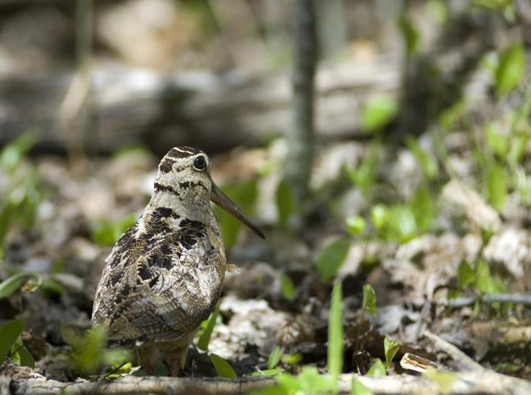
Thank you for your participation in the American Woodcock Singing-ground Survey!
For further questions or clarifications please contact
Becky Rau, National SGS Coordinator, (WeblessSurveyCoordinator@fws.gov)

